Slide 1
P1067
High Cloud Airline Analysis
Presented by
Group-5

Slide 2

Our Team Members
Ayush Sandeep Firke
Laxmi Basavaraj Byahatti
Tanay Nagar
Hotkar Ashish
Geddamuri Sri Sai
SANTANU KARMAKAR
Ravi kanth

Slide 3
Tools USED
EXCEL
POWER BI
TABLEAU
MYSQL

Slide 4
Contents
Introduction
Business Overview
Project Scope
Data Model Challenges
Dashboard Overview
Suggestions and comments

Slide 5
Objective
To gain a comprehensive understanding of “High Cloud Airlines” operation through data analysis. This will involve investigation load factor, identifying top carrier names based on passenger preference, analyzing popular routes, and exploring other key metrics. The ultimate goal is to provide actionable recommendations that can enhance operational efficiency and profitability.

Slide 6
Business Overview
In today’s competitive airline industry, data analysis plays a critical role in optimizing operations and maximizing profitability. By harnessing the power of data, High Cloud Airlines can gain valuable insights into various aspects of its business, allowing them to make data-driven decisions that can lead to
Improves load Factor
Enhanced Passenger Experience
Optimized Resource Allocation
Data-Driven Decision Making

Slide 7
Project Scope
This Project aimed to leverage the power of data analysis and extract valuable insights to optimize High Cloud Airlines operations and performance. The specific scope of project focused on analyzing key performance indicators(KPIs) to gain a deeper understanding of :
Load Factor
Passenger Preferences
Popular Routes
Operational Efficiency

Slide 8
Data Model Challengers
Throughout our analysis, we encountered various challengers in handling the data. Overcoming these challenges is crucial for accurate insights.
Data Volume : Managing and processing large datasets efficiency.
Data Quality : Ensuring accuracy and reliability of the data.
Complex Relationships : Establishing connections between different data points.

Slide 9
Dashboards

Slide 10
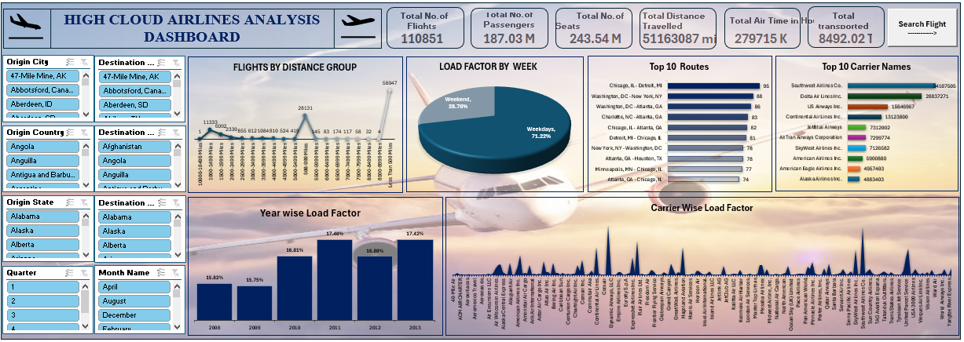
Excel Dashboard

Slide 11
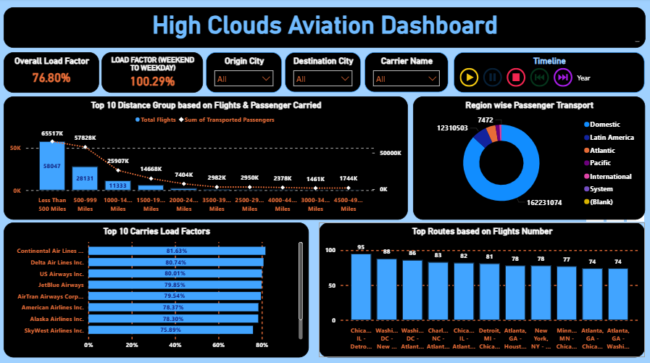
Power BI Dashboard

Slide 12
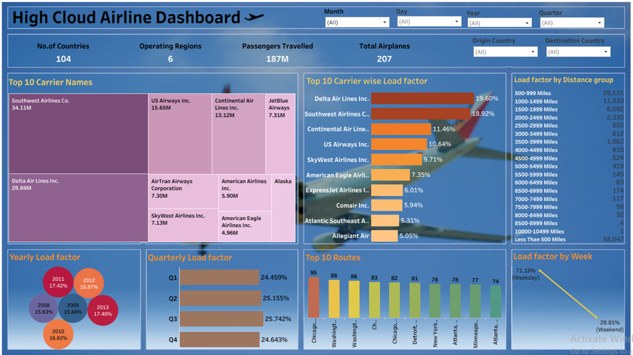
Tableau Dashboard

Slide 13
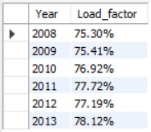
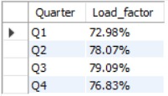

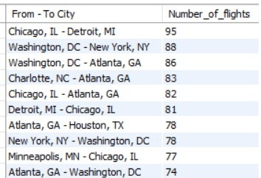
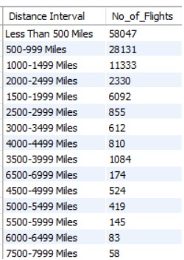
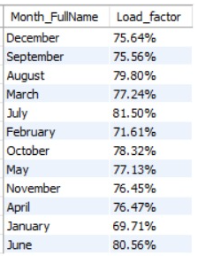
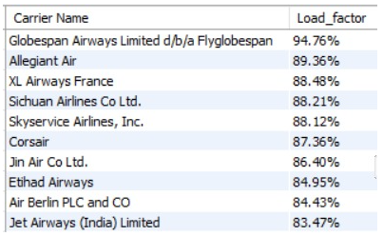
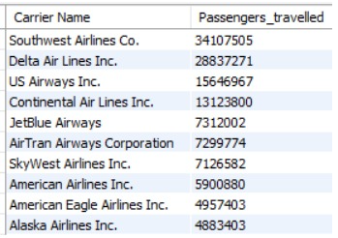
MySQL Queries Outputs
Yearly Load Factor
Quarterly Load Factor
Load Factor by week
Top 10 Routes
No of Flights by Distance Interval
Month wise Load Factor
Top 10 Carrier Names wise Load Factor
Top 10 Carrier wise Passenger Travelled

Slide 14
Recommendations
Optimize Flight Routes : Utilize insights from top routes and flights to optimize schedules and resources allocation.
Enhance Load Factor : Leverage load factor analysis to identify trends and implement strategies for increased efficiency.
Strategic Carrier Partnerships : Collaborate with top carriers to maximize passenger transportation and enhance overall performance.
Resource Allocation : Allocate resources strategically based on flight schedules and passenger volume data. This efficient operations and minimizes wait times at airports with high passenger traffic.

Slide 15
Conclusions
High Cloud Airlines empowers the activation industry with actionable insights efficiency and strategic decision-making. The presented KPIs offer into the vast potential for improvement and growth within the industry. By harnessing the power of data, we can drive positive changes, ensuring a brighter future for High Cloud Analysis and its partners in the aviation sector.

Slide 16
Thank You

